Slide 1
Data Science 21CSAI01I
Group No. : 14
Soha Ashraf. 205001
Mariam Saeed. 203891
Notes:
Line spacing + Page numbers

Slide 2
Outline
01 Introduction
02 Problem statement
03 Dataset Cleaning
04 Data Scraping
05 Questions and Visualization
06 Obstacles
07 References

Slide 3
Introduction
1
In phase1 :
1 main dataset is used : Crimes - 2001 to present (Chicago)
In this dataset, the data is very large and messy as its size is: Rows: 7.5M, Columns: 22.
Cleaning and tidy the data to make it easy to analysis the dataset.
Add some questions to get more information easily and by using visualization to analysis.
In phase 2:
3 datasets are used: 1. The main dataset : Crimes - 2001 to present (Chicago)
2. The scraped dataset: Crime in the United States (USA), Rows: 24, Columns: 20.
3. The other dataset (used in data integration): Public School in Chicago, Rows: 566, Columns: 79.
In the 2nd dataset, it used to be scraped from FBI website to get the table of data as DataFrame.
The 2nd and 3rd datasets are integrated with the main dataset to answer the questions and their visualization.

Slide 4
Problem Statement
2
Our main dataset is very large, so there may be missing values and unnecessary columns and rows.
So, we cleaned the dataset by dropping some unnecessary columns.
Replacing the missing values or nulls values by 0 or null.

Slide 5
Datasets Cleaning:
3
In the main dataset (Crimes - 2001 to present (Chicago) ):
The dataset is very large as there a lot of unnecessary columns and missing values.
Dropped columns: Location, Dates , updated on date
Replacing the missing values with 0, 1 for numeric values and “Null” for the string values.
In the scraped dataset (Crime in the United States (USA) ):
- There were two table in the HTML code, so to get the first table is by dropping the second one.
In the other dataset (Public School in Chicago):
There were a lot of columns are not needed to integrated with the main dataset, so we dropped some columns.

Slide 6
Data Scrapping:
4
- The scrapped dataset: Crime in the United States (USA).
To get the scrapped dataset as a dataframe, by importing BeautifulSoup library.
Searching from the table class in the html code for the columns and rows “th”, “tr” and save the columns as lists then saved in a dataframe.
In this dataset, it have all the crime types and its rate through from 1994 : 2013.
- And integrated with the main dataset to answer and analysis the data.

Slide 7
Questions and Visualization:
5
Q1) What is the ratio of crime based on crime types?
Q2) What is the period between the date of the crime and the date it was updated?
Q3) During the summer months, what the higher rate of crimes happened this time?
Q4) How did the crimes effect on safety score in the community area? And what are the safety icon?
Q5) What is the location in every community area that a crime happened in it?
Q6) Are the changes that done from 2001 to 2013 affected on property crime and in which community area?
Q7) What is the ratio or rate of crimes based on the robbery rate that the criminals successful arrested?
Q8) Which year has more crime rate?

Slide 8
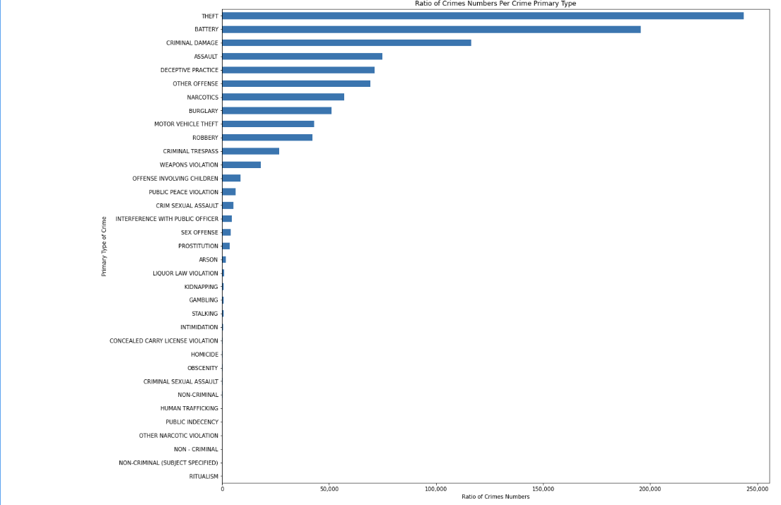
Q1) What is the ratio of crime based on crime types?
- As in this plot, we can see that the primary type of crimes which have higher rate is “Theft”. And the lowest rate is “Ritualism”.

Slide 9
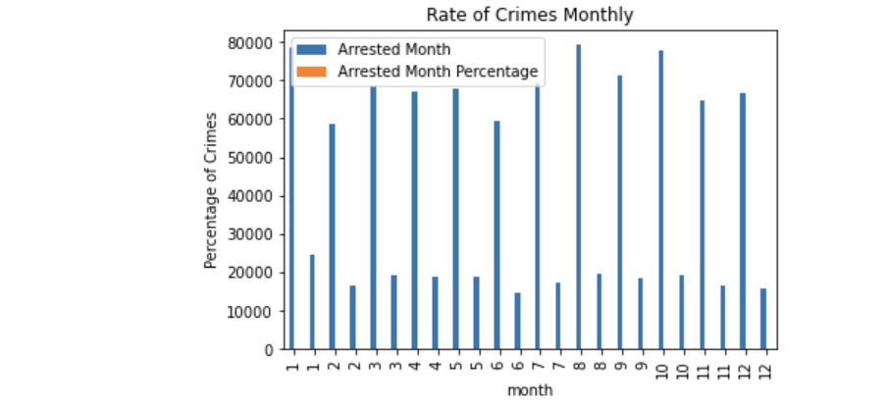
Q2) What is the period between the date of the crime and the date it was updated?
- The time period between the date of the crime and its update date is needed to know what are the cases that took much time and if there are cases still in progress.

Slide 10
Q3) During the summer months, what the higher rate of crimes happened this time?
- According to the visualization, in August the rate of crimes is increased because this month in the summer and people went out to the beach to take their vacation. So, the criminals appear currently. There are some researchers about it, as the people in the summer leave their homes because of the increase of the temperature, so there a lot of crimes happen this time. In my opinion, this will help me not to live the home at these days or not to travel to this city at these months.

Slide 11
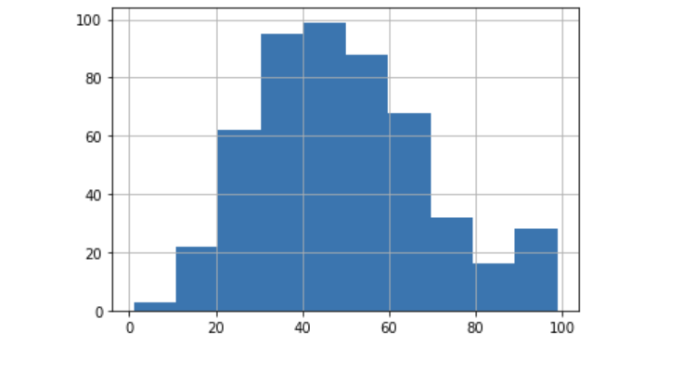
Q4) How did the crimes effect on safety score in the community area? And what are the safety icon?
Each community area has its own safety score. The safety icons have many types each one of them has its own meaning.

Slide 12
Obstacles:
6
We have many problems in integration and visualization.
Scraped data take more time because the data dropped while scraping it.

Slide 13
References:
7
Crimes - 2001 to present (Chicago) (Press "Export").
https://data.cityofchicago.org/Public-Safety/Crimes-2001-to-present/ijzp-q8t2 [Accessed in 2.3.2022].
2. Crime in the United States (USA).
https://ucr.fbi.gov/crime-in-the-u.s/2013/crime-in-the-u.s.-2013/tables/1tabledatadecoverviewpdf/table_1_crime_in_the_united_states_by_volume_and_rate_per_100000_inhabitants_1994-2013.xls[Accessed in 9.3.2022].
3. Public School in Chicago.
https://data.cityofchicago.org/Education/Chicago-Public-Schools-Progress-Report-Cards-2011-/9xs2-f89t[Accessed in 9.3.2022].

Slide 14
THANK YOU

